Slide 1
FAIR data at European XFEL
Hans Fangohr, Robert Rosca
Trieste, Italy
05 November 2019

Slide 2
FAIR
A first glance

Slide 3
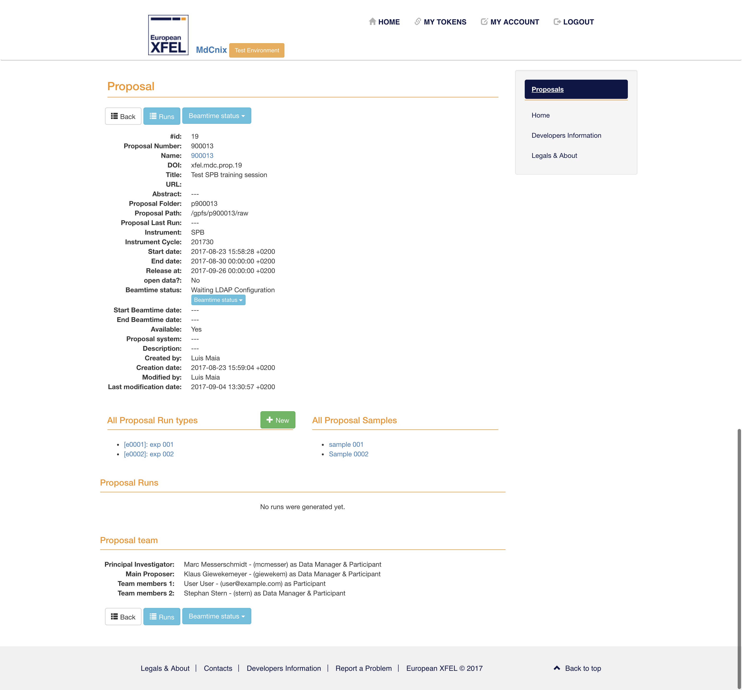
FAIR – Findable
MetaDataCatalog searchable by users
Developments in WP3 will extend on that
Proposals (beamtimes) get DOI
Might be useful with smaller granularity (per sample?)
F1. (Meta)data are assigned a globally unique and persistent identifier
Internal DOI created per proposal, published when made public
F2. Data are described with rich metadata
No standardised list of required metadata
Frequently missing key information (e.g. detector distance)
F3. Metadata clearly and explicitly include the identifier of the data they describe
F4. (Meta)data are registered or indexed in a searchable resource
Partially, metadata is searchable by proposal title, but not by contents of metadata (e.g. cannot search by sample name)

Slide 4
FAIR – Accessible
PaNdata based data policy with 3 year embargo
MetaDataCatalogue
Metadata accessible even if the data is not accessible
Has API, supports authentication
Will be extended by WP3
Same standard as other facilities
A1. (Meta)data are retrievable by their identifier using a standardised communications protocol
Metadata catalogue has a API
Data?
A2. Metadata are accessible, even when the data are no longer available
Catalogue entries exist even if the data is not accessible
A1.1 The protocol is open, free, and universally implementable
Protocol is for internal use only, based on RRESTful API
A1.2 The protocol allows for an authentication and authorisation procedure, where necessary
Authentication is required to access the catalogue
Cannot read metadata without having an EuXFEL account

Slide 5
FAIR – Interoperable
Metadata
No
WP3 will help
Data
No
Use hdf5 everywhere
EuXFEL specific data structure in hdf5 files
I1. (Meta)data use a formal, accessible, shared, and broadly applicable language for knowledge representation.
No?
I2. (Meta)data use vocabularies that follow FAIR principles
No?
I3. (Meta)data include qualified references to other (meta)data
References to related experiments/samples are not made

Slide 6
FAIR – Reusable
Reusability
Lack of metadata for re-usability:
Not all metadata stored in meta data catalog / data files
PI and experiment team has additional knowledge
Links to Roberto’s remark on engaging PI with ‘customers’ downloading the data set later
Instrument (beamline) scientist has additional knowledge
Metadata R1. Meta(data) are richly described with a plurality of accurate and relevant attributes
No
R1.2. (Meta)data are associated with detailed provenance
Provenance information is not stored
Some information in eLogs
Calibration logs not searchable
R1.3. (Meta)data meet domain-relevant community standards
No standards have been adopted by the community yet?
Developed in parts through PaNOSC?
R1.1. (Meta)data are released with a clear and accessible data usage license
Maybe - [TODO: what license do we have for the actual metadata?]

Slide 7
Working towards FAIR – examples from European XFEL
Robert Rosca, Thomas Kluyver, Thomas Michelat, Hans Fangohr

Slide 8
Data storage in HDF5 files
[fangohr@max-exfl014]/gpfs/exfel/exp/SPB/201701/p002012/raw/r0359% ls –lh total 92G -rw-r--r-- 1 xdata xdata 6.1G Jul 6 11:03 RAW-R0359-AGIPD00-S00000.h5 -rw-r--r-- 1 xdata xdata 6.1G Jul 6 11:03 RAW-R0359-AGIPD01-S00000.h5 -rw-r--r-- 1 xdata xdata 6.1G Jul 6 11:03 RAW-R0359-AGIPD02-S00000.h5 -rw-r--r-- 1 xdata xdata 241K Jul 6 11:03 RAW-R0359-AGIPD03-S00000.h5 -rw-r--r-- 1 xdata xdata 6.1G Jul 6 11:03 RAW-R0359-AGIPD04-S00000.h5 -rw-r--r-- 1 xdata xdata 6.1G Jul 6 11:03 RAW-R0359-AGIPD05-S00000.h5 -rw-r--r-- 1 xdata xdata 6.1G Jul 6 11:03 RAW-R0359-AGIPD06-S00000.h5 -rw-r--r-- 1 xdata xdata 6.1G Jul 6 11:03 RAW-R0359-AGIPD07-S00000.h5 -rw-r--r-- 1 xdata xdata 6.1G Jul 6 11:03 RAW-R0359-AGIPD08-S00000.h5 -rw-r--r-- 1 xdata xdata 6.1G Jul 6 11:03 RAW-R0359-AGIPD09-S00000.h5 -rw-r--r-- 1 xdata xdata 6.1G Jul 6 11:03 RAW-R0359-AGIPD10-S00000.h5 -rw-r--r-- 1 xdata xdata 6.1G Jul 6 11:03 RAW-R0359-AGIPD11-S00000.h5 -rw-r--r-- 1 xdata xdata 6.1G Jul 6 11:03 RAW-R0359-AGIPD12-S00000.h5 -rw-r--r-- 1 xdata xdata 6.1G Jul 6 11:03 RAW-R0359-AGIPD13-S00000.h5 -rw-r--r-- 1 xdata xdata 6.1G Jul 6 11:03 RAW-R0359-AGIPD14-S00000.h5 -rw-r--r-- 1 xdata xdata 6.1G Jul 6 11:03 RAW-R0359-AGIPD15-S00000.h5 -rw-r--r-- 1 xdata xdata 788M Jul 6 11:03 RAW-R0359-DA01-S00000.h5 -rw-r--r-- 1 xdata xdata 38M Jul 6 11:03 RAW-R0359-DA02-S00000.h5

Slide 9
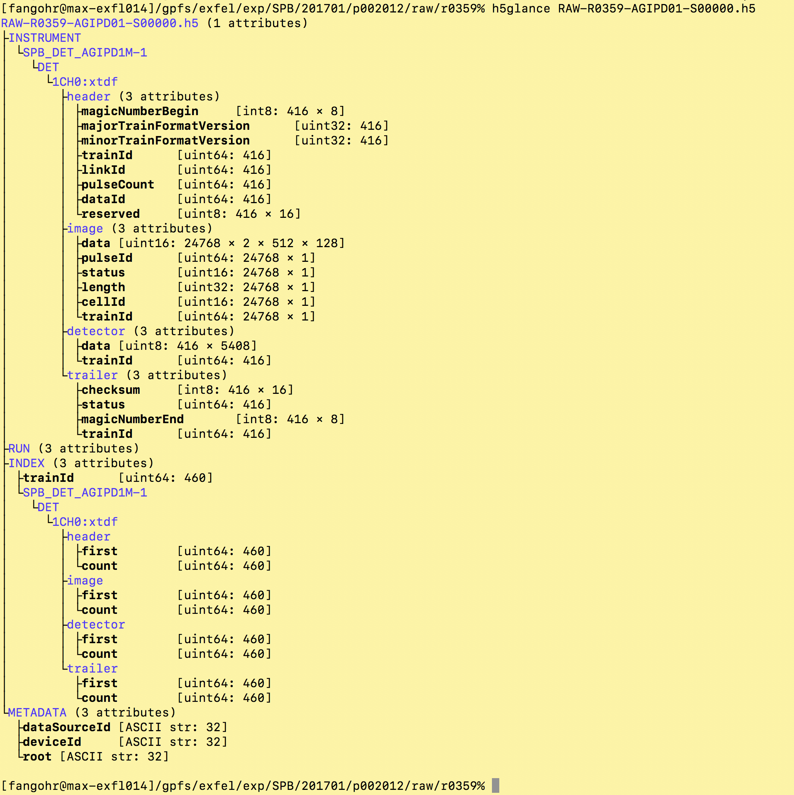
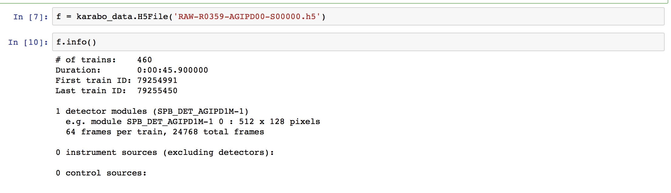

Slide 10
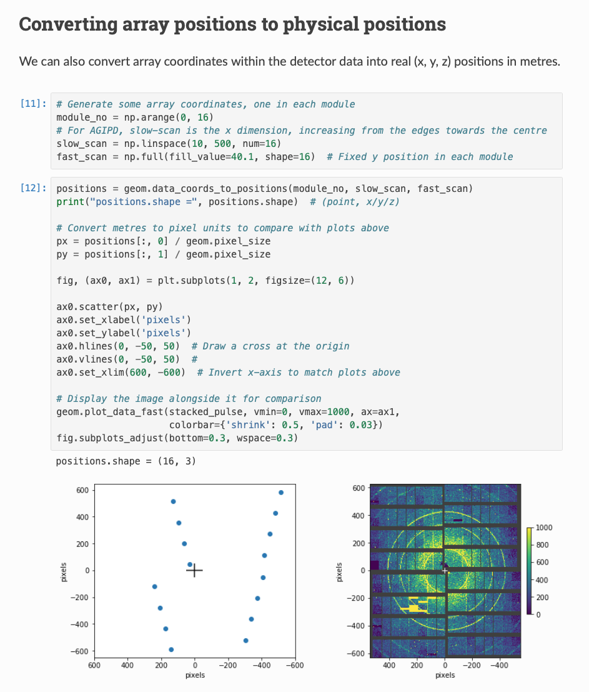
Abstracting HDF5 data layer access (Thomas Kluyver)
Python library which provides convenient interface for reading data
Hides implementation of storage in multiple files
Hides space saving non-storage of missing frames
Saves users writing boilerplate code for multiple common use cases
Reading and aligning data from multiple files
Applying detector geometry
Plotting 2D detector images
Exports to standard data science libraries (xarray, pandas, numpy, dask)
Provides data analysis capabilities in notebook

Slide 11
Creating libraries of relevant analysis recipes
Data analysis library built on notebooks
One template notebook per experiment/analysis type
Directory structure with notebooks
Given to users in proposal data folder
Feedback from instrument and users
Positive
Research questions
How to manage hundreds of modified notebooks that emerge during beamtime?
Or maybe we don’t have to?

Slide 12
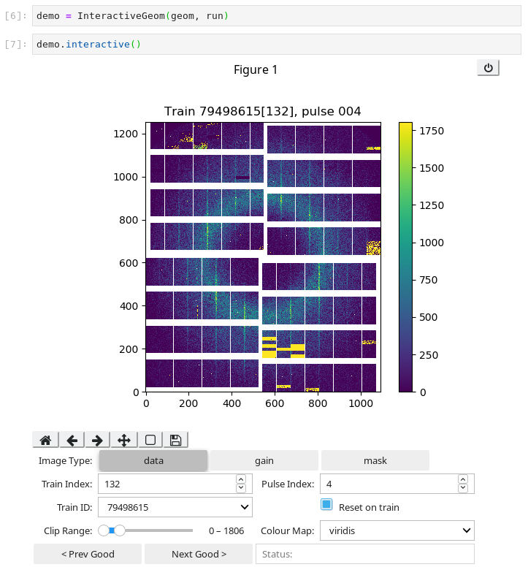
Interactive data exploration in notebook (Robert Rosca)
Karabo Data Interactive
Jupyter widget built on Karabo Data and IPyWidgets
Allows for interactive data exploration and analysis in a notebook
Extensible – written to make it easy to add in different plot types and functions
e.g. recently added support for interactive masking and azimuthal integration

Slide 13
Geometry assembler (1/2)
Moving detector quadrants
Detector quadrants can be move by motor
Need to know exact positions (“geometry”) to interpret recorded data
“GeoAssembler” software allows to
Put geometrical objects (sphere) on top of
(powder) diffraction pattern
to determine positions
Metadata R1. Meta(data) are richly described with a plurality of accurate and relevant attributes
No
R1.2. (Meta)data are associated with detailed provenance
Provenance information is not stored
Some information in eLogs
Calibration logs not searchable
R1.3. (Meta)data meet domain-relevant community standards
No standards have been adopted by the community yet?
Developed in parts through PaNOSC?
R1.1. (Meta)data are released with a clear and accessible data usage license
Maybe - [TODO: what license do we have for the actual metadata?]

Slide 14
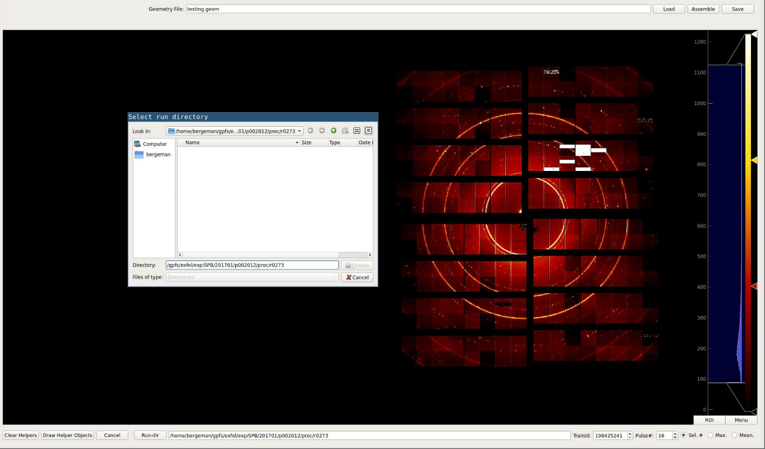
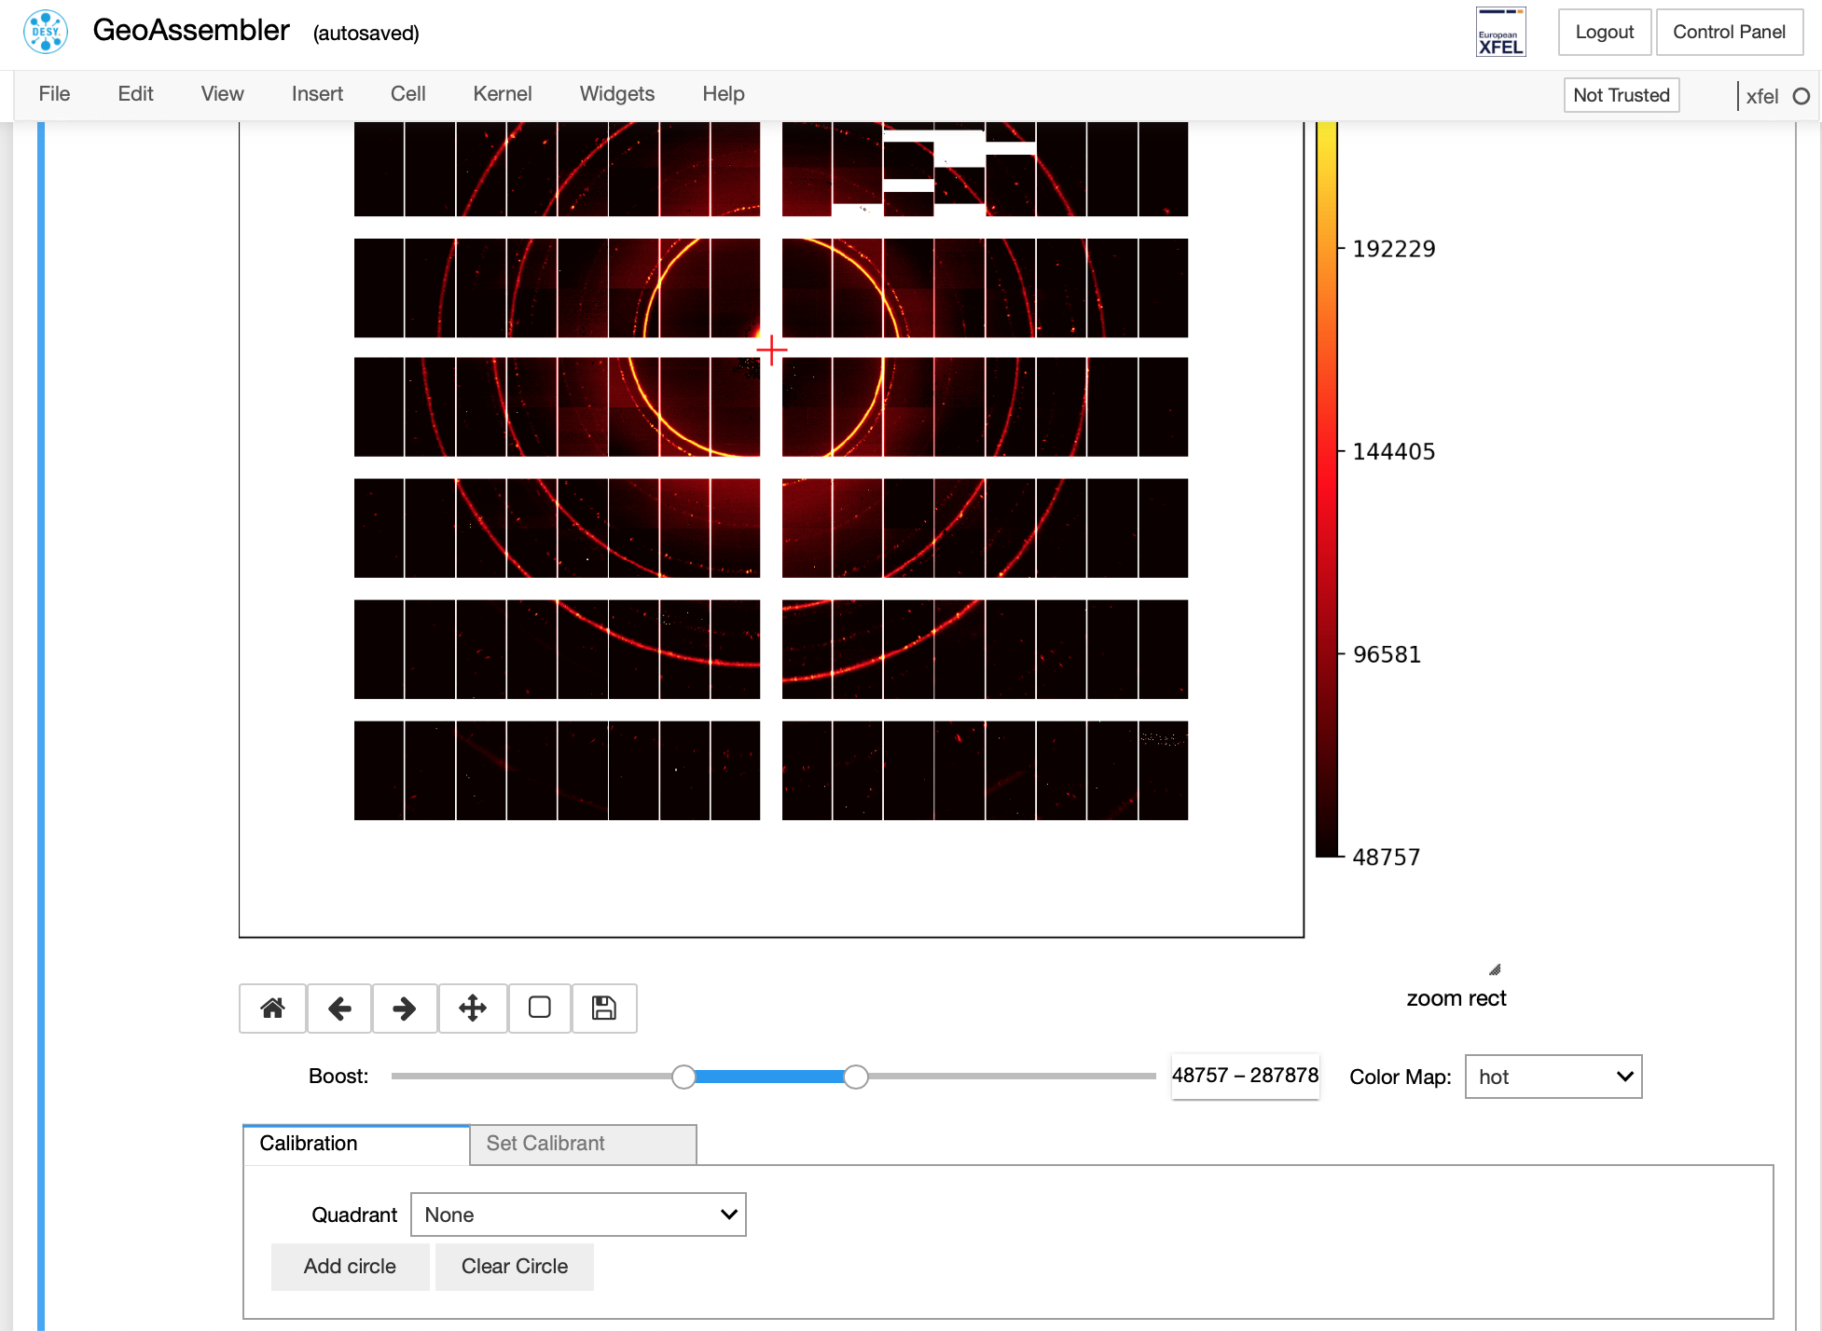
Geometry assembler (2/2)
Two implementations
Using QT
Using Jupyter Notebook
Notebook version “surprisingly” popular
Metadata R1. Meta(data) are richly described with a plurality of accurate and relevant attributes
No
R1.2. (Meta)data are associated with detailed provenance
Provenance information is not stored
Some information in eLogs
Calibration logs not searchable
R1.3. (Meta)data meet domain-relevant community standards
No standards have been adopted by the community yet?
Developed in parts through PaNOSC?
R1.1. (Meta)data are released with a clear and accessible data usage license
Maybe - [TODO: what license do we have for the actual metadata?]

Slide 15
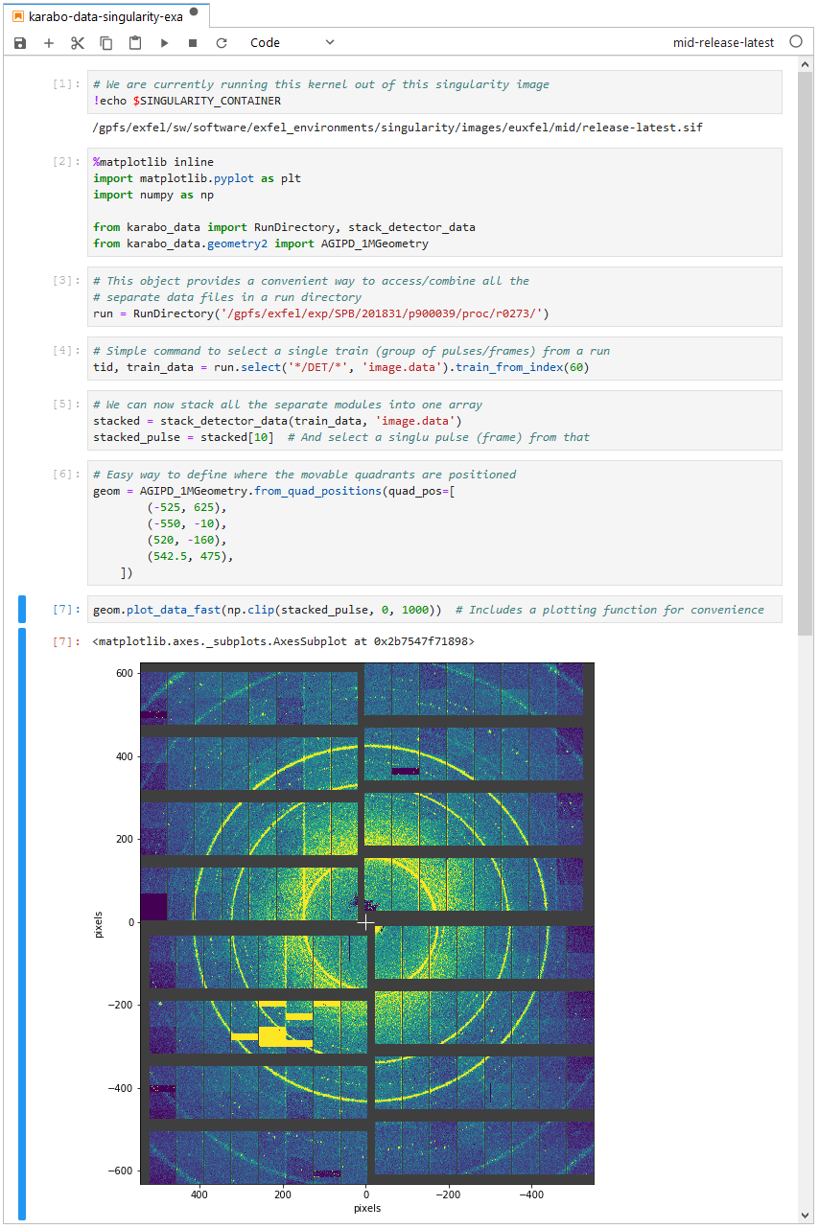
Containers for software provision and deployment (Robert Rosca)
Software environments packaged in Singularity containers
Containers include tests at build time to ensure software works
Updated and deployed via GitLab CI
Used in prototype situations to deploy software (OnDA at SPB, Custom software at MID)
Containers can be versioned to support reproducibility
Highly portable – copy over one file to get entire software environment
Containers can be exposed as a Jupyter kernel to facilitate easily reproducible and transferable notebooks

Slide 16
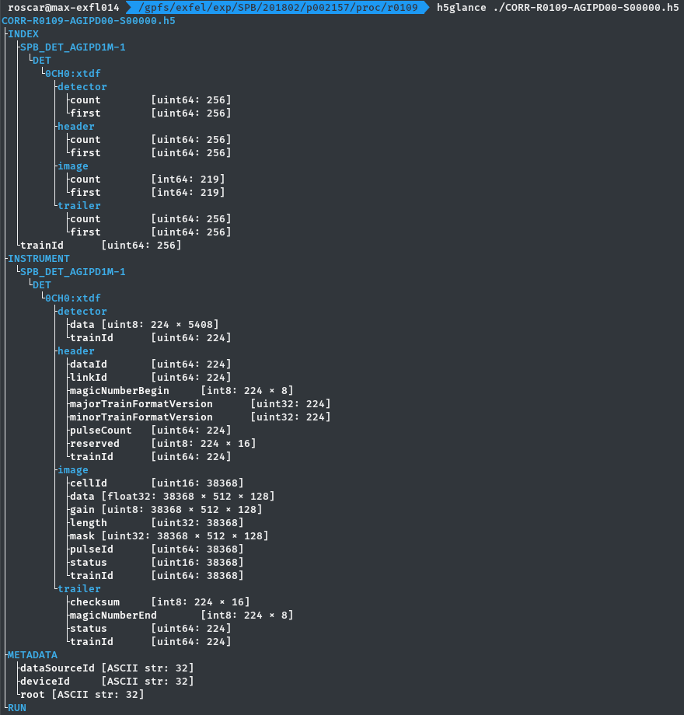
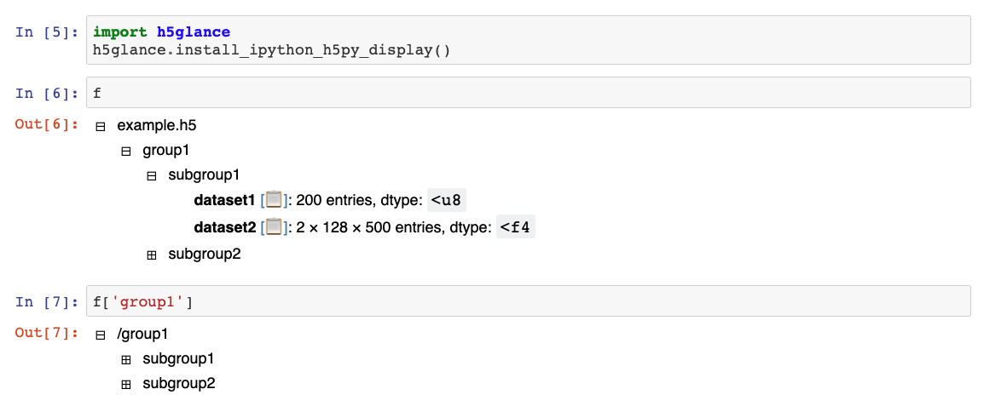
HDF5 (Thomas Kluyver)
Contribute to h5py
Support of virtual data sets
“Export” EuXFEL files for CrystFEL
H5glance – exploring hdf5 files from terminal and notebook

Slide 17
Summary
FAIR data
Very demanding
Perfection difficult (impossible?) to achieve
Other activities and tools
Integrated into production to varying degree
Exchange with other facilities very useful
Joint use of libraries and tools such as pyFAI, h5py, Jupyter
Contributing to open source tools

